Slide 1
NFP Design Techniques
Software Architecture
Lecture 20

Slide 2
Complexity
IEEE Definition
  Complexity is the degree to which a software system or one of its components has a design or implementation that is difficult to understand and verify
Complexity is a software system’s a property that is directly proportional to the size of the system, number of its constituent elements, their internal structure, and the number and nature of their interdependencies

Slide 3
Software Components and Complexity
Separate concerns into different components
Keep only the functionality inside components
  Interaction goes inside connectors
Keep components cohesive
Be aware of the impact of off-the-shelf components on complexity
Insulate processing components from changes in data format

Slide 4
Software Connectors and Complexity
Treat connectors explicitly
Keep only interaction facilities inside connectors
Separate interaction concerns into different connectors
Restrict interactions facilitated by each connector
Be aware of the impact of off-the-shelf connectors on complexity

Slide 5
Architectural Configurations and Complexity
Eliminate unnecessary dependencies
Manage all dependencies explicitly
Use hierarchical (de)composition

Slide 6
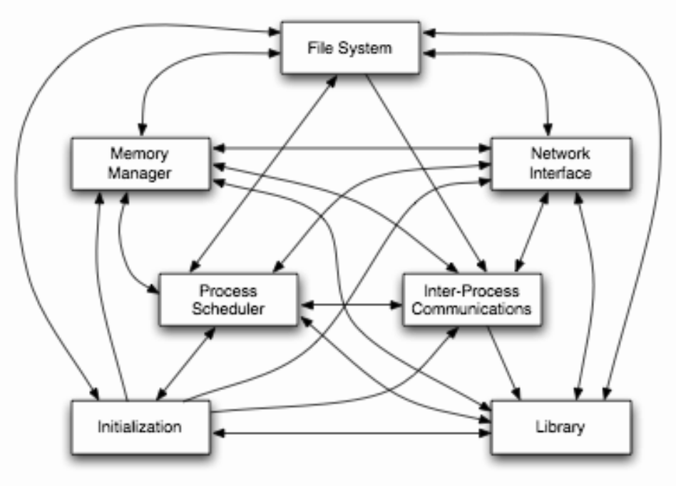
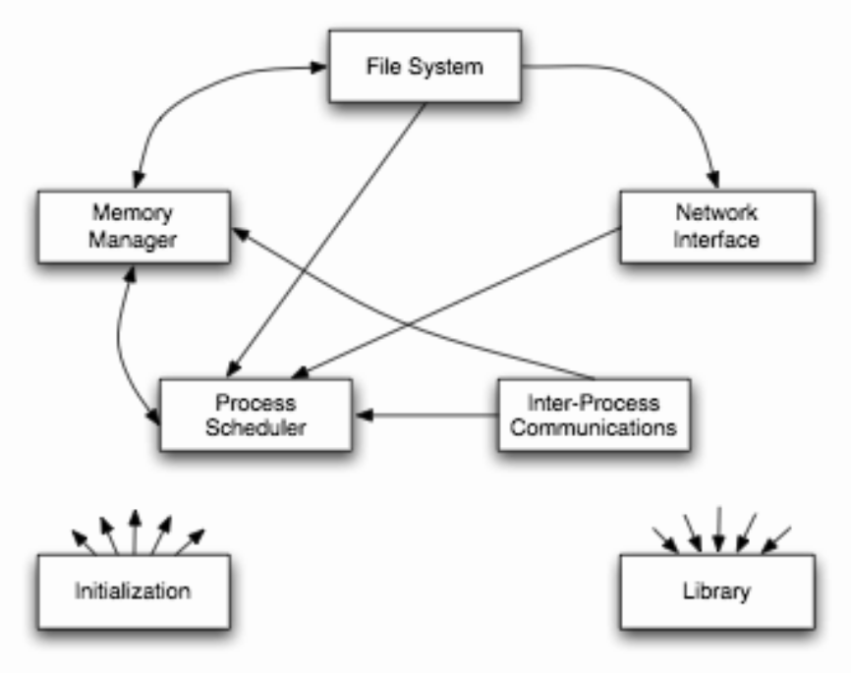
Complexity in Linux
Software Architecture: Foundations, Theory, and Practice; Richard N. Taylor, Nenad Medvidovic, and Eric M. Dashofy; © 2008 John Wiley & Sons, Inc. Reprinted with permission.

Slide 7
Scalability and Heterogeneity
Scalability is the capability of a software system to be adapted to meet new requirements of size and scope
Heterogeneity is the quality of a software system consisting of multiple disparate constituents or functioning in multiple disparate computing environments
  Heterogeneity is a software system’s ability to consist of multiple disparate constituents or function in multiple disparate computing environments
  Portability is a software system’s ability to execute on multiple platforms with minimal modifications and without significant degradation in functional or non-functional characteristics

Slide 8
Software Components and Scalability
Give each component a single, clearly defined purpose
Define each component to have a simple, understandable interface
Do not burden components with interaction responsibilities
Avoid unnecessary heterogeneity
  Results in architectural mismatch
Distribute the data sources
Replicate data when necessary

Slide 9
Software Connectors and Scalability
Use explicit connectors
Give each connector a clearly defined responsibility
Choose the simplest connector suited for the task
Be aware of differences between direct and indirect dependencies
Avoid placing application functionality inside connectors
  Application functionality goes inside components
Leverage explicit connectors to support data scalability

Slide 10
Architectural Configurations and Scalability
Avoid system bottlenecks
Make use of parallel processing capabilities
Place the data sources close to the data consumers
Try to make distribution transparent
Use appropriate architectural styles

Slide 11
Adaptability
Adaptability is a software system’s ability to satisfy new requirements and adjust to new operating conditions during its lifetime

Slide 12
Software Components and Adaptability
Give each component a single, clearly defined purpose
Minimize component interdependencies
Avoid burdening components with interaction responsibilities
Separate processing from data
Separate data from metadata

Slide 13
Software Connectors and Adaptability
Give each connector a clearly defined responsibility
Make the connectors flexible
Support connector composability

Slide 14
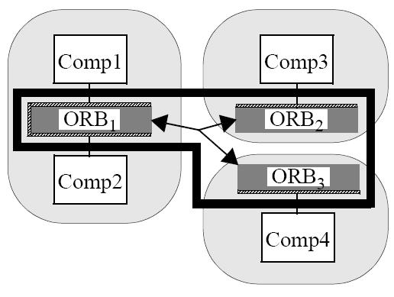
Composable Connectors
Software Architecture: Foundations, Theory, and Practice; Richard N. Taylor, Nenad Medvidovic, and Eric M. Dashofy; © 2008 John Wiley & Sons, Inc. Reprinted with permission.

Slide 15
Architectural Configurations and Adaptability
Leverage explicit connectors
Try to make distribution transparent
Use appropriate architectural styles

Slide 16
Dependability
Dependability is a collection of system properties that allows one to rely on a system functioning as required
  Reliability is the probability that a system will perform its intended functionality under specified design limits, without failure, over a given time period
  Availability is the probability that a system is operational at a particular time
  Robustness is a system’s ability to respond adequately to unanticipated runtime conditions
  Fault-tolerant is a system’s ability to respond gracefully to failures at runtime
  Survivability is a system’s ability to resist, recognize, recover from, and adapt to mission-compromising threats
  Safety denotes the ability of a software system to avoid failures that will result in (1) loss of life, (2) injury, (3) significant damage to property, or (4) destruction of property

Slide 17
Software Components and Dependability
Carefully control external component inter-dependencies
Provide reflection capabilities in components
Provide suitable exception handling mechanisms
Specify the components’ key state invariants

Slide 18
Software Connectors and Dependability
Employ connectors that strictly control component dependencies
Provide appropriate component interaction guarantees
Support dependability techniques via advanced connectors

Slide 19
Architectural Configurations and Dependability
Avoid single points of failure
Provide back-ups of critical functionality and data
Support non-intrusive system health monitoring
Support dynamic adaptation

